Slide 1
Traveling Route Generation System
Project Status Presentation III
Zhang Yong, Li Zhihui, Liu Ziyi
3 July, 2019

Slide 2
CONTENTS
Demo
Data Storage
Prospect

Slide 3
Demo
01

Slide 4
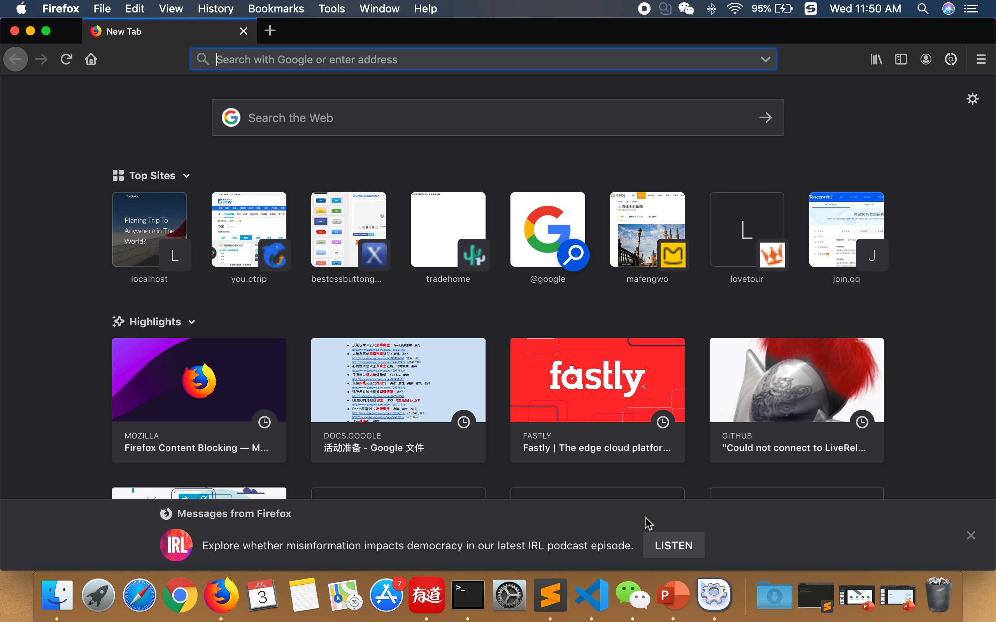

Slide 5
Data Storage
02

Slide 6
Why do we need storage system?
We have a city list of 1800+ cities, some of them are not in popular demand.
It is impossible to store all of these cities’ information completely.
So when user inputs one city for the first time, system crawls the information and store it. Others input it next time, information will be read from storage system directly.
Cities

Slide 7
Data Storage Flow Chart
input
City name
NO
Create Cityname.json
Cityname.json file exist?
YES
Crawl city information
Parse json file
Write and store json file
Parse json file
output
City information
Algorithm

Slide 8
Data Format
File name: “Nanjing.json”
Content:
{
“cityName” : “南京”,
“recommendedDays” : 3,
“cityImage” : “Nanjing.jpg”,
“spots” : [
{
“name” : “夫子庙”,
“address” : “江苏省南京市秦淮区贡院西街53号”,
“image” : “nj_01.jpg”,
“rank” : 1,
“recommendedTime” : 3.5,
“location” : {
“lat” : 32.027082,
“lng” : 118.795235
}
“detail” : “……”
},
{
…
}
],
}

Slide 9
Prospect
03
Already illustrated before.
Thank you for your listening.

